Slide 1
Understanding the Movie Industry
Market Penetration Strategy: Budget-Genre-Crew Strategy
DN Movie Industry Consulting Firm
Dmitry Mikhaylov & Ngoc Tran
Jun 19, 2019

Slide 2
Three Success Factors for Market Penetration Strategy
Is it worth it? The industry is booming but:
Production budgets and ticket sales vary significantly
Need to analyse specific budget categories to get actionable insights
Focused approach and budgetary controls
What genres should we focus on?
Genres popularity ratings, mean and variances analysis
Whom should we hire?
Most popular actors, actresses, directors, and writers
Budget
Genre
Crew

Slide 3
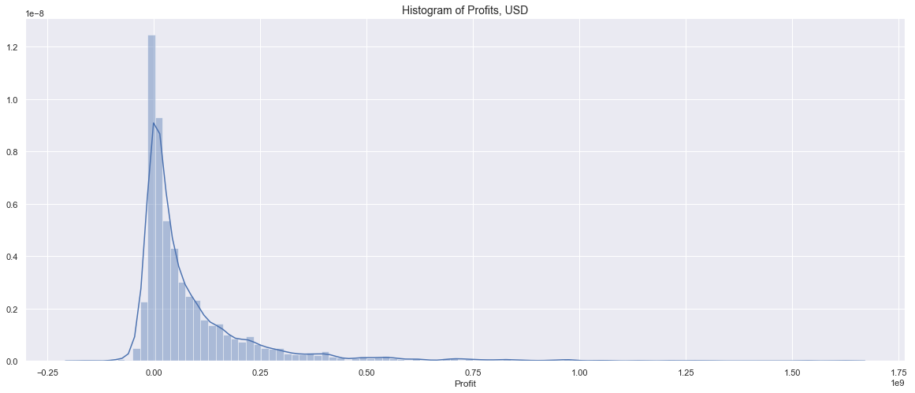
Industry Profitability Analysis
Target this range
Possible losses
It is hard to make a lot of money

Slide 4
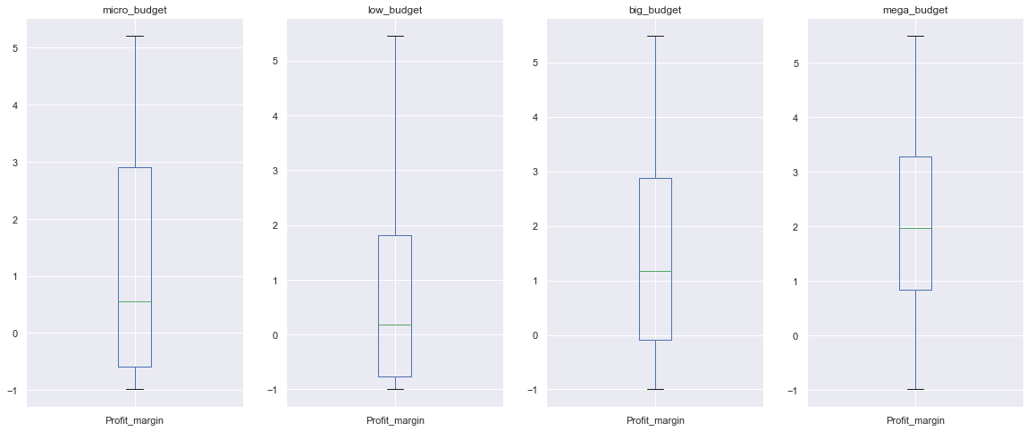
Budget Categorization
micro: <= 50K
low: 50K - 3M
big: 3M - 50M
mega: > 50M
Sweet spot
High risk & high reward
Hard to cover overhead
Tends to lose money
Notes:
Sample counts, show breakeven at 0

Slide 5
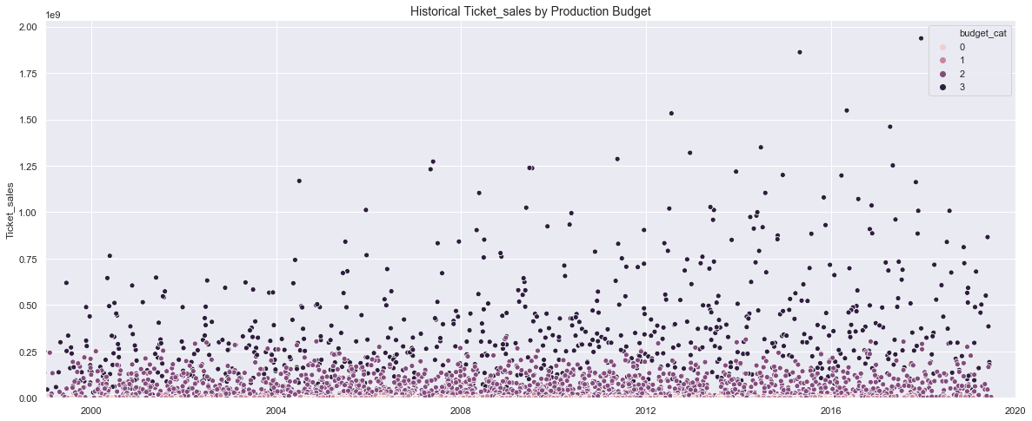
Empirical Map of the Industry
micro <=50K
low <= 3M
big <= 50M
mega > 50M
Notes:
Pick 4 completely different colors

Slide 6
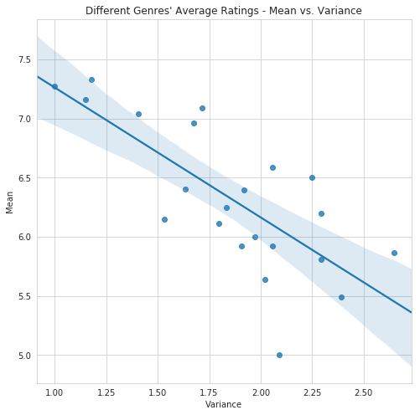
Genres
News
Biography
Documentary
High Mean - Low Variance!
(It’s good to be consistently good)
Notes:
Interesting finding:
High performers: news, biography, documentary, and history.
These categories focus on (hopefully) facts.
Point out bottom right
Expalin variance

Slide 7
Movie Crew
Actors | Actresses | Directors | Writers
Timothy J. Cox | Lauren Lopez | Josh Lowell | Nick Rosen
Joshua Bell | Lelani Mitchem | Tim Van Someren | Alvaro Calderón
Ian Cranston | Sargun Mehta | Nick Rosen | Matt Lang
Kalyan Chatterjee | Sylvia Earle | Joshua Bell | David Anghel
Michael Henry | Jayani Senanayake | Nick Wickham | Eric Frith
Thumindu Dodantenne | CC King | Carlos Nader | Darren Wilson
Om Bhutkar | Susan Brown | Thom Zimny | Brian Holden
Notes:
This is a list of several good actors, actresses, directors, and writers.
Each of these people has participated in at least 5 movies that have average rating above 8.
Add pics

